Slide 1
Market w/conf idence
Wednesday, December 11, 2024
See Chicago Dance
December Community Convening
Erik Kaiko
Hubbard Street Dance Chicago, Director of Marketing & Communications
ekaiko@hubbardstreetdance.com
erik.kaiko@gmail.com
Just one person’s thoughts on marketing & communications for scrappy scenarios.

Slide 2
AGENDA
Introduction
Marketing Objectives
The Fogg Behavior Model
Marketing Strategies
Takeaways
Q&A

Slide 3
I’m Erik!
Artist turned administrator(/artist)
Bachelor of Science in Theatre, Sociology Minor
MFA in Theatre Management & Producing
Press & Public Relations
Budgeting
Accounting
Marketing & Advertising
Joey Parnes Productions, New York Theatre Workshop, Writers Theatre, Hubbard Street Dance Chicago
Company Management, General Management, Producing, Marketing

Slide 4
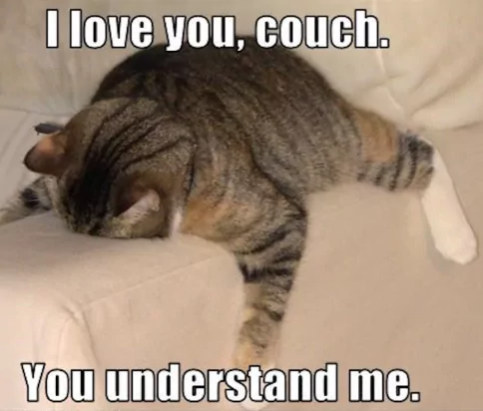
Why Marketing? Do we have to?
We want to alter peoples’ behavior.
Not buying a ticket -> buying a ticket
Not following you on IG -> following you on IG
Not watching your video -> watching your video
We want to communicate with enough impact that we overcome inertia.

Slide 5
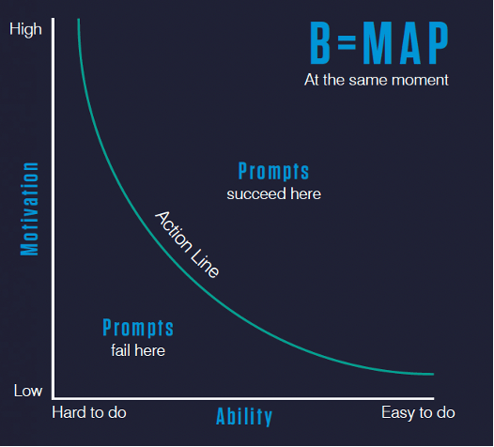
The Fogg Behavior Model
“The Fogg Behavior Model shows that three elements must converge at the same moment for a behavior to occur: Motivation, Ability, and a Prompt.
“Behavior happens when Motivation, Ability, and a Prompt come together at the same time. When a behavior does not occur, at least one of those three elements is missing.”
https://behaviormodel.org/

Slide 6
The Fogg Behavior Model in Action
When you:
Post something on social media,
Send an email,
Talk to a potential funder,
Offer a discount…
Think about a specific objective for each piece of communication.
Are we trying to generate Motivation within the patron by telling a compelling story about the performance?
Are we trying to communicate how easy/cheap something is to do? (Ability)
Are we sharing a beautiful picture as a short and sweet reminder for the patron to act? (Prompt)

Slide 7
The Fogg Behavior Model in Action
If you are in the middle of a campaign that does not seem to be performing, look at your content and your campaign as a whole, and try to identify what element may be missing for the patron: Motivation, Ability, Prompt.
A more proactive way to think about this:
“If you’re unsure how to simplify a desired behavior, look at which factor is scarcest at the time of your prompt. How can you reduce it or address it at that moment?”
https://boldist.co/marketing-strategy/fogg-behavior-model/

Slide 8
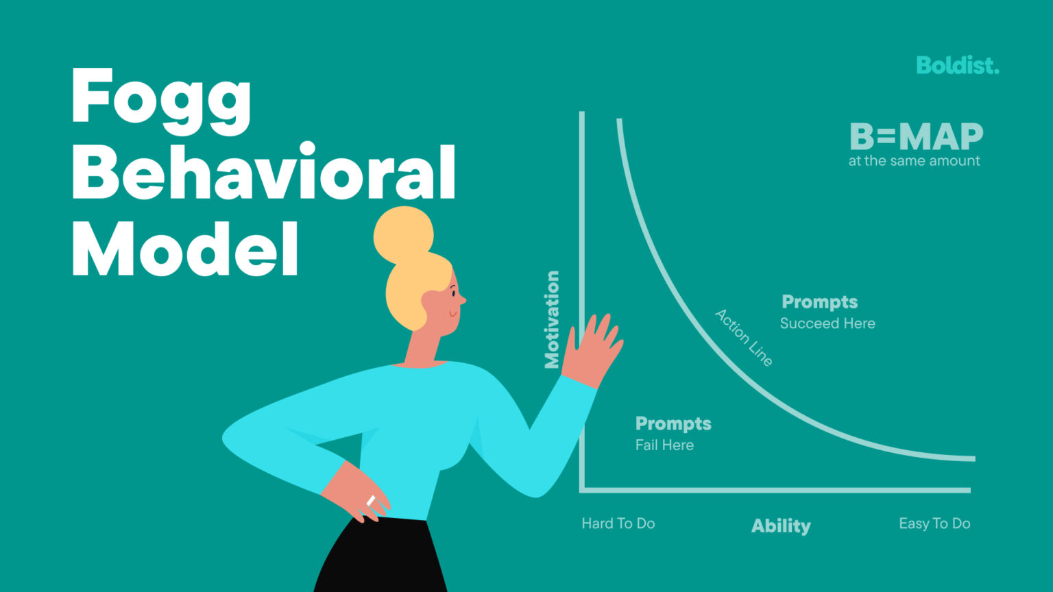
Marketing Strategies based on the FBM
How do we increase Motivation?
How do we communicate Ability?
How do we effectively deploy Prompts?
https://boldist.co/marketing-strategy/fogg-behavior-model/

Slide 9
Strategy 1: MOTIVATION
THE GOAL:
Tap into factors intrinsic to the human experience to increase the level of motivation.
EXAMPLE:
Show how attending the intimate workshop invites the patron to be part of a community.
Use ‘fear-of-missing-out’ to tell the patron that they must act ASAP before the concert sells out.
Share joyful behind-the-scenes content if the patron can expect a fun/pleasurable experience at the exhibit.

Slide 10
Strategy 2: ABILITY
THE GOAL:
Make it easy for the patron to take the desired action by increasing their level of ability.
EXAMPLE:
Is ticket price a barrier? Offering a discount increases financial ability.
Are there too many steps? Consider what you are asking the patron to do: is there a simpler way to do it?
How much knowledge are you assuming the potential patron already has? Can you educate them to reduce the mental workload next time?

Slide 11
Strategy 3: PROMPTS
THE GOAL:
Give the patron the opportunity to take the desired action by providing a prompt. (a.k.a. “trigger,” “call-to-action,” etc.)
EXAMPLE:
Has it been a while since you’ve posted? Sometimes (if they already possess the Motivation and the Ability), all people need is a reminder.
Are you concerned that your content is too verbose? Consider something shorter and straight-to-the-point for variety and to stimulate the patron differently.

Slide 12
More about The Fogg Behavior Model
From Dr. BJ Fogg himself: https://behaviormodel.org/
A user-friendly, digestible guide with examples: https://boldist.co/marketing-strategy/fogg-behavior-model/

Slide 13
Clear up the Fogg, Erik.
How can small companies and independent artists incorporate these strategies with limited resources?
What sets you and your work apart? (Motivation)
You are one-of-a-kind. Show that authentically and honestly.
Don’t be afraid to tell your story, warts and all.
Use your assets to your advantage.
Reduce friction wherever possible. (Ability)
Distill down to the essentials. What do you really need?
Think about your own pain points as a consumer. What makes you procrastinate, and what breaks you out of that cycle?
Simplify.
Make noise! (Prompts)
If you are worried about posting/sharing/emailing too much or too frequently – instead of pulling back on volume, re-think your messaging and consider a different objective.
This does not necessarily mean creating more/different content. It may just mean repackaging.
Stay top-of-mind.

Slide 14
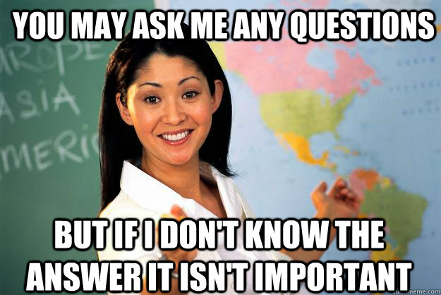
Ask me questions!

Slide 15
Market w/conf idence
Wednesday, December 11, 2024
See Chicago Dance
December Community Convening
Erik Kaiko
Hubbard Street Dance Chicago, Director of Marketing & Communications
ekaiko@hubbardstreetdance.com
erik.kaiko@gmail.com
Just one person’s thoughts on marketing & communications for scrappy scenarios.

